Slide 1

Play Store App Analysis
By: Atheeqa Shafee

Slide 2
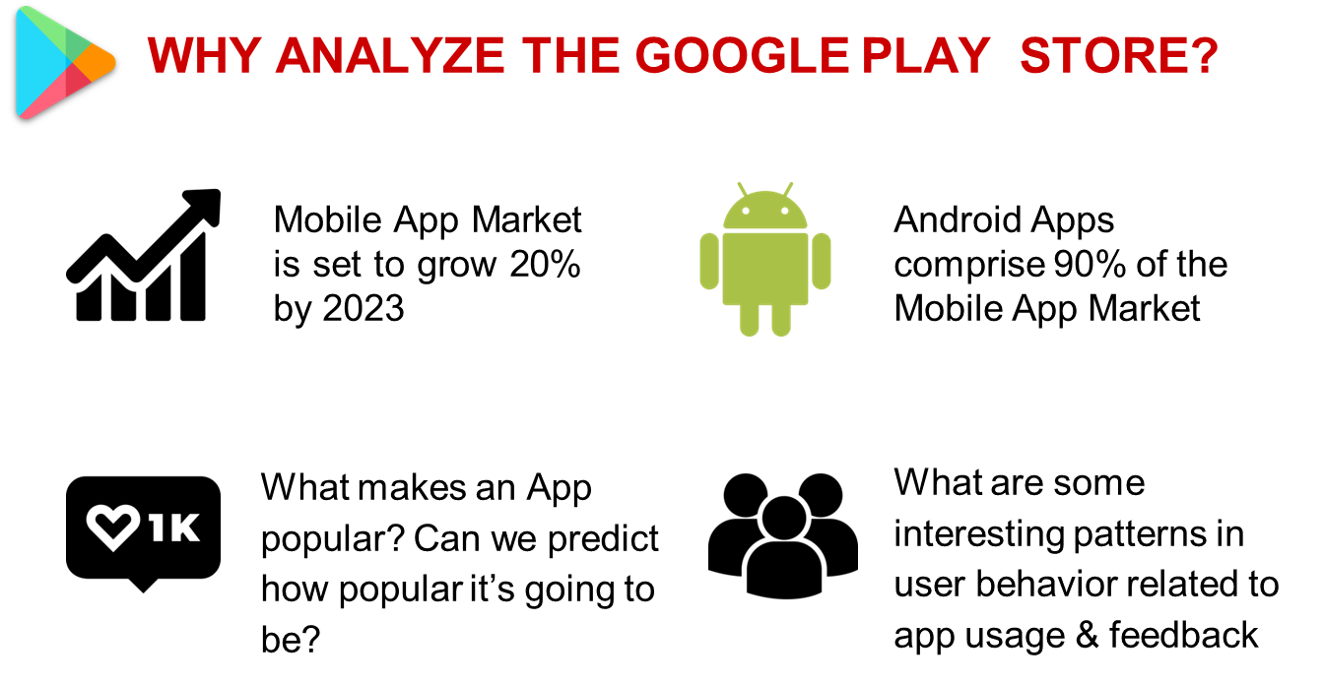
WHY ANALYZE THE GOOGLE PLAYSTORE?

Slide 3
Introduction
Play store is an Android Market serves as the official app store for certified devices running on the Android Operating system. Developed and Operated by Google, launched on 6thMarch, 2012.
1.45 million different apps are available for users to download. Android users have even more from which to choose, with 2.56 million available through the Google Play Store. Play store apps have their own features such as Ratings, Reviews, Size and more. From the problem statement given, we should analyze the given database and should come up with the key factors that increased the number of users, long term usage etc., the objective of this project is to deliver insights to understand customer demands better and thus help developers to popularize the product.

Slide 4

Problem Statement
Today, 1.45 million different apps are available for users to download. Android users have even more from which to choose, with 2.56 million available through the Google Play Store. These apps have come to play a huge role in the way we live our lives today.
Our Objective is to find the Most Popular Category, find the App with largest number of installs , the App with largest size etc.

Slide 5

Project Agenda
Understanding the Problem Statement
Data Collection
Exploratory data analysis
Data Analyzation to find the insights
Data Cleaning
Data Pre-Processing & Feature Engineering
Model Training
Model Evaluation
Hyperparameter Tunning
Choose best model

Slide 6
Attributes in our Dataset
App: This column Contains the name of the app for each observation.
Category :This column Contains Category to which the app belongs.
Rating : This column contains the average rating for the app.
Reviews : This column contains the number of reviews that the app has received on the play store.
Size: This column contains the amount of memory the app occupies on the device.
Installs: This column contains the number of times that the app has been downloaded and installed from the play store.
Type : This column contains the information whether the app is free or paid.
Price: If the app is a paid app, this column contains the data about its price.
Content Rating: This column contains the maturity rating of the app i.e. the age group of the audience for which it is suitable.
Genres: This column contains the data about to which genre the app belongs. Genres can be considered as a further division of the group of Category.
Last Updated: Contains the date on which the latest update of the app was released.
Current Version: Contains information on the current version of the app available on the play store.
Android Version: Contains information about the android versions on which the app is supported.

Slide 7
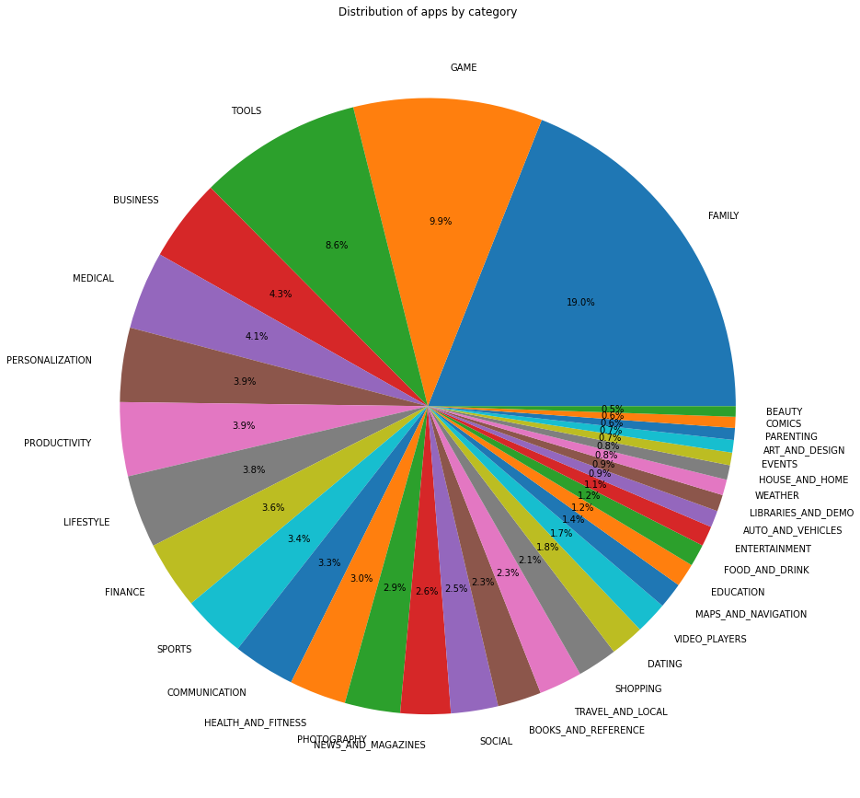
Which is the most popular app category ?
There are more kinds of apps in play store which are under category of family, games & tools.
Beauty, comics, arts and weather kinds of apps are very less in play store.
Most Popular app is Family category

Slide 8
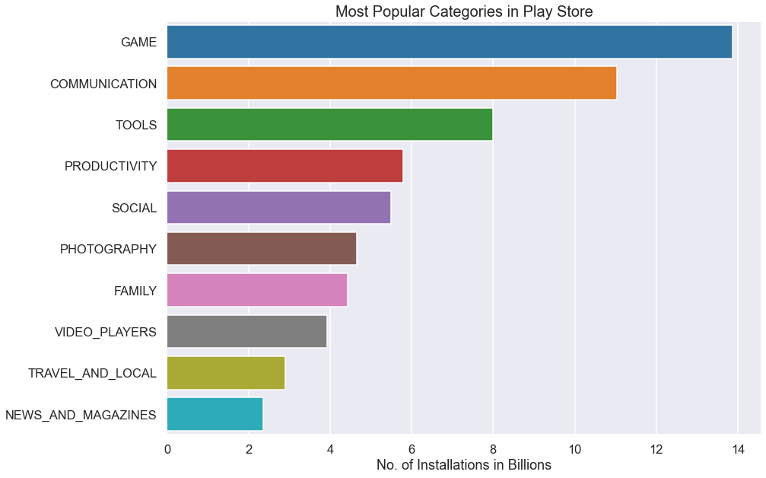
Which Category has largest number of installations?
Out of all the categories "GAME" has the most number of Installations.
With almost 35 Billion Installations GAME is the most popular Category in Google App store.

Slide 9
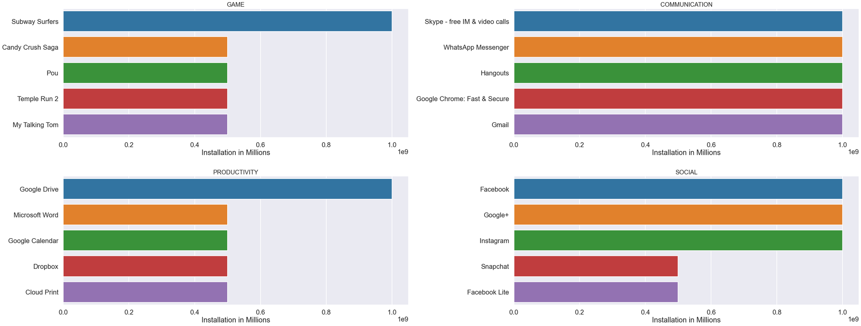
What are the Top 5 most installed Apps in Each popular Categories ?
Most popular game is Subway Surfers.
Most popular communication app is Hangouts.
Most popular productivity app is Google Drive.
Most popular social app is Instagram.

Slide 10
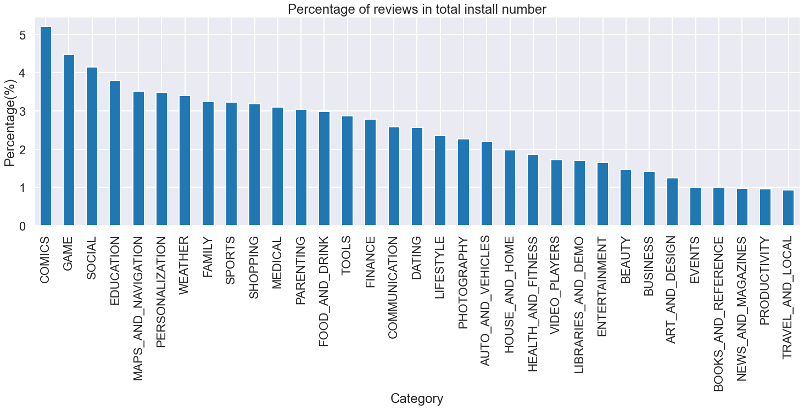
Which Category app users are reviewing the most ?
Users downloading "Comics" with higher rate to leave a review but with relative high spread of the rating comparing with others.
"Comic" ranks 6 in the number of installation.
The two categories with high download rate are having relatively low review rate.

Slide 11
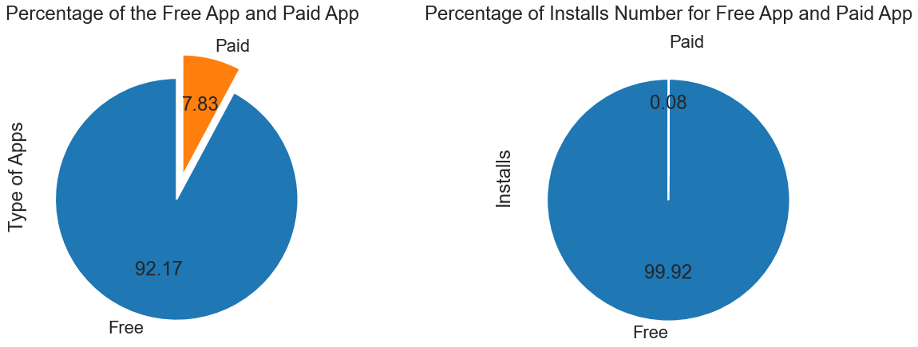
Which kinds of apps users are downloading the most- free/ paid?
More than 92% of the are free in Google Play Store.
More than 99% of installs belongs to free apps.
Most of the apps in the app store are free.
Only a small percentage of apps are paid apps.

Slide 12
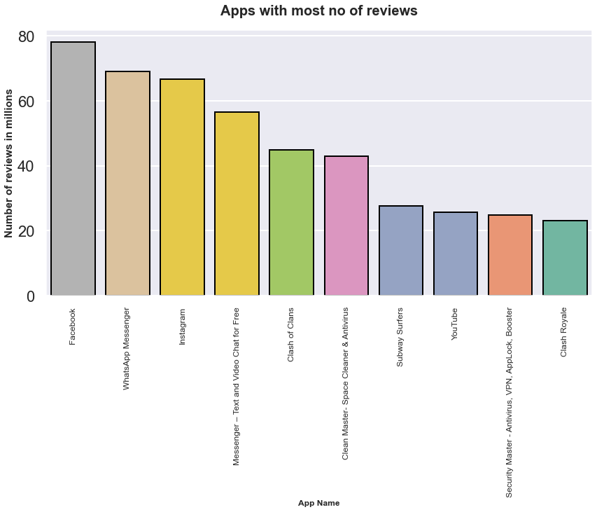
Which app with most number of reviews and its number of reviews?
Facebook app has largest number of reviews followed by WhatsApp.

Slide 13
Conclusions
The higher the rating, more people will be inclined to download the app.
Better the Reviews more are the chances for the app to be downloaded by more people.
People are always inclined to download apps that are free of cost.
Apps that falls under the Content Rating, 'Everyone', 'Teens' and 'Everyone 10+' has the highest chance to be downloaded.
The apps with smaller sizes have more chance to be downloaded.
Subway surfer is the most downloaded app followed by Instagram, Hangouts and Google Drive
92.6% of the apps in the app store are free.

Slide 14


